Slide 1
Introduction of Mobile Application
Abdifatah Yassen

Slide 2
What is a mobile app (mobile application)?
A mobile app (or mobile application) is a software application developed specifically for use on small, wireless computing devices, such as smartphones and tablets, rather than desktop or laptop computers.

Slide 3
continue
Mobile apps are sometimes categorized according to whether they are web-based or native apps,(A native app is an app that is developed for one particular operating system (e.g., iOS or Android) only) which are created specifically for a given platform. A third category, hybrid apps, combines elements of both native and web apps.
A web-based mobile app, also known as a mobile web app, is a type of application that is accessed through a mobile device’s web browser, rather than being downloaded and installed from an app store.

Slide 4
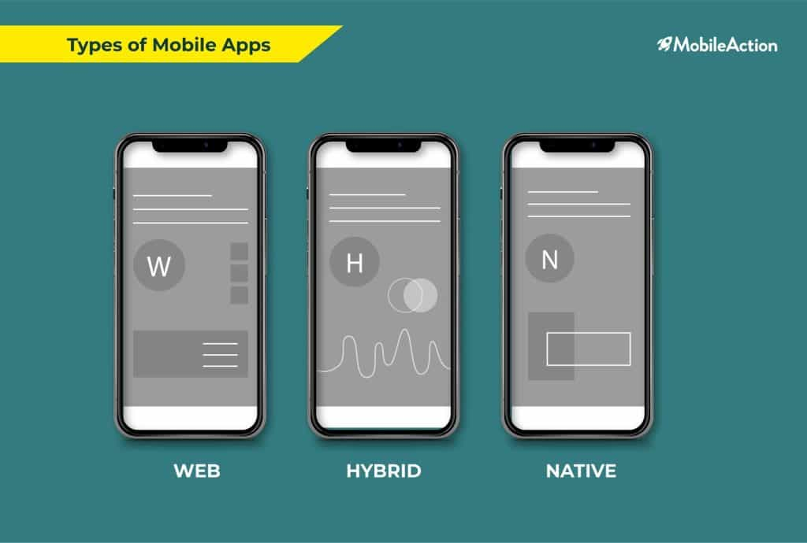
Types of mobile Apps

Slide 5
In today's digital age, mobile apps are an essential part of most people's daily lives. From social networking and entertainment to productivity and business, mobile apps play a vital role in how we interact with technology.

Slide 6
How are mobile apps built?
Mobile apps are built using a variety of programming languages and frameworks, and they can be downloaded and installed from app stores such as the Apple App Store or Google Play.

Slide 7
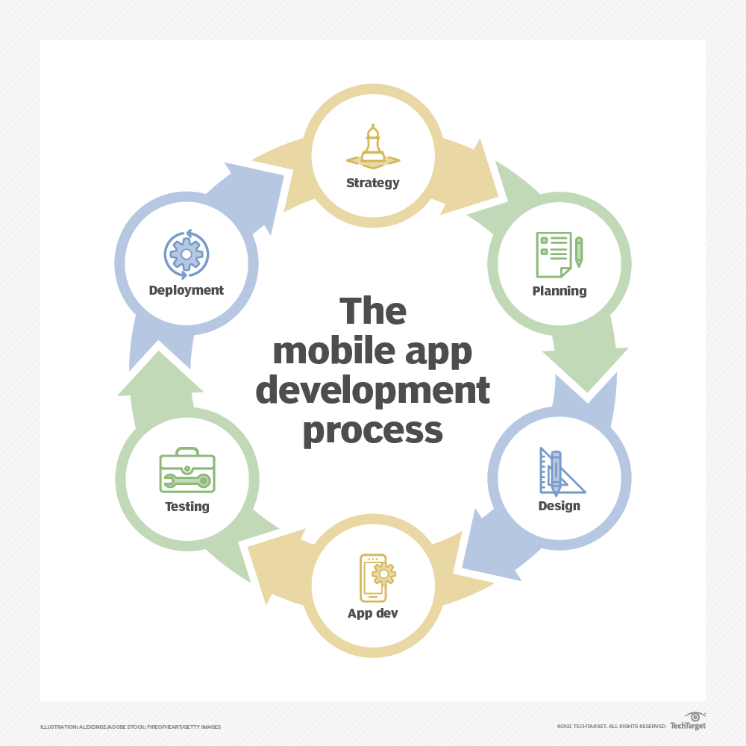
The mobile app development cycle

Slide 8
How does a mobile app work?
1. Mobile apps are made for specific phone operating systems like iOS, Android, or Windows.
2. When you download and install a mobile app, it's saved in your phone's memory.
3. Your phone's operating system is used to open and run the installed app.

Slide 9
4- When a user opens a mobile app, the app communicates with the device's operating system and other built-in software components to access the device's hardware and services such as the camera, GPS and internet connection. The app then uses this information to provide its specific functions and services to the user.

Slide 10
Advantages of mobile apps
Convenience(the quality of being suitable to one's comfort, purposes, or needs). Mobile apps can be downloaded and installed on a device, allowing users to access the app's functions and services at any time, from anywhere.
Personalization. Mobile apps can be customized to meet the specific needs of individual users, providing a personalized experience.
Offline access. Many mobile apps can be used offline, providing access to important information and features even when an internet connection is not available.
Push notifications. Mobile apps can send push notifications to users, providing real-time updates on important information and events.

Slide 11
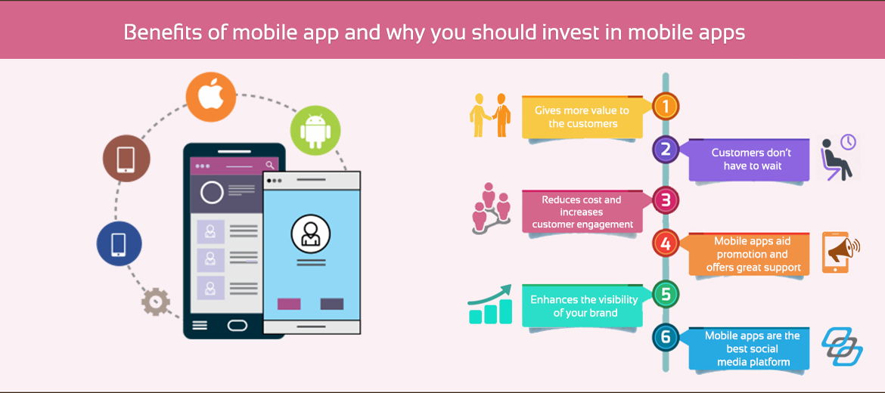
Benefits for mobile apps in real word

Slide 12
Disadvantages of mobile apps
Limited functionality. Mobile apps are designed to provide specific functions and services, and they might not be able to provide the same level of functionality as a desktop application.
Limited compatibility. Mobile apps are designed to run on specific mobile operating systems, and they might not be compatible with all devices.
Security concerns. Mobile apps can access sensitive information on a device, and they might not have the same level of security as a desktop application.
Limited updating capability. Some mobile apps might not be easily updated, and users might need to download a new version of the app to access the latest features and bug fixes.

Slide 13
Is my phone listening to me?
https://www.youtube.com/watch?v=CVazBWGgg64

Slide 14
The evolution of mobile Apps
1. Early Days (1990s-early 2000s):
- Mobile phones could only make calls and send basic text messages.
- Simple pre-installed apps like calendars, calculators, and address books were available.

Slide 15
2. Smartphone Revolution (mid-2000s):
- Smartphones like the iPhone and Android devices became popular.
- App stores were created, allowing users to download and install various apps.
- Apps expanded beyond basic functions to include games, productivity tools, and more.

Slide 16
3. App Ecosystem Growth (2010s):
- The number of available apps grew exponentially as smartphones became widespread.
- Apps became more sophisticated, leveraging device features like cameras, sensors, and GPS.
- Apps started providing a wide range of services, from social media to banking and e-commerce.

Slide 17
4. Current Trends (2020s):
- Mobile apps continue to evolve, with features like augmented reality, machine learning, and integration with smart home devices.
- Apps are now an essential part of our daily lives, used for communication, entertainment, productivity, and much more.

Slide 18
augmented reality
Augmented reality (AR) is an interactive experience that combines the real world and computer-generated 3D content.
https://www.youtube.com/watch?v=XPNUmcEOYW0

Slide 19
Who created first mobile app
The first mobile app was created in the early 1990s by IBM. The IBM Simon, a touchscreen phone, was released in 1993 and came with a variety of apps, including a calendar, address book, and notepad. This device was the first to introduce the concept of mobile apps, paving(early pioneers) the way for the development of more sophisticated apps in the years to come.

Slide 20
Early Mobile Apps
In the early days of mobile phones, apps were limited to simple games, calculators, and calendar functions. The first Java games and a monthly calendar were some of the earliest mobile apps. The BlackBerry Smartphone, released in 2002, was another significant milestone in the development of mobile apps, introducing wireless email and other innovative features.

Slide 21
What is Flutter?
Flutter is an open-source(open-source mobile applications are software applications that are freely available for use, modification, and distribution by anyone. )mobile application development framework created by Google.
Flutter was first released in May 2017.
It allows developers to build high-performance, visually attractive, and natively compiled mobile applications for both iOS and Android platforms.

Slide 22
Key Features of Flutter
- Cross-platform development
- Fast development cycle
- Expressive and flexible UI
- Native performance
- Wide range of widgets and tools

Slide 23
Cross-platform development:
- Flutter allows you to build apps for both iOS and Android using the same codebase.
- This means you don't have to write separate code for different platforms.

Slide 24
Fast development cycle:
- Flutter's hot reload feature allows you to see changes in your app instantly.
- This speeds up the development process and makes it easier to iterate on your app.

Slide 25
Expressive and flexible UI:
- Flutter provides a wide range of customizable widgets to build beautiful user interfaces.
- You can create unique and visually appealing designs for your app.

Slide 26
Native performance:
- Flutter's engine is designed to deliver performance that is on par with native apps.
- Your Flutter app will feel just as smooth and responsive as a native app.

Slide 27
Wide range of widgets and tools:
- Flutter comes with a large collection of pre-built widgets for common UI elements.
- You also have access to a growing ecosystem of plugins and tools to extend your app's functionality.

Slide 28
Dart Language
- Dart is the programming language used to build Flutter applications.
- It is designed for creating fast and responsive apps on any platform.

Slide 29
Flutter Framework
- The Flutter framework provides a rich set of pre-built widgets and tools.
- Widgets are the fundamental building blocks of a Flutter app.
Declarative UI:
- Flutter uses a declarative approach to building user interfaces.
- This means you describe what the UI should look like, and Flutter handles the rendering.

Slide 30
What Do Students Need to Know Before Flutter Framework?
Before diving into the Flutter framework, there are a few important concepts and skills that students should have a good understanding of to ensure a smooth and productive learning experience:
Programming Fundamentals:
Proficiency in the Dart programming language is highly recommended.
Knowledge of basic programming concepts like data types, control structures, functions, and object-oriented programming.
Mobile App Development Basics:
Familiarity with the core components of mobile app development, such as UI elements, navigation, and application lifecycle.
Understanding of the differences between iOS and Android platforms and their respective design patterns and guidelines..

Slide 31
Software Development Principles:
Have understanding of software design patterns, data structures, and algorithms.
Ability to write clean, maintainable, and testable code.
Dart Programming Language:
Thorough understanding of the Dart programming language, as it is the primary language used in Flutter development.
Knowledge of Dart's syntax, data types, control flow, and object-oriented features.

Slide 32
Version Control and Tooling:
Familiarity with version control systems, such as Git, and the ability to use them effectively.
Familiarity with popular Integrated Development Environments (IDEs) like Android Studio, Xcode, or Visual Studio Code.
Problem-Solving and Debugging Skills:
Ability to analyze and debug code, identify and fix issues, and handle errors and exceptions.
Strong problem-solving skills to tackle complex challenges during the development process.

Slide 33
Why Searching Skills are important for developers?
Accurate Information Gathering: Developers need to gather accurate and relevant information to solve complex problems, understand requirements, and implement solutions. Research skills help them find the right information, evaluate its credibility, and apply it effectively.

Slide 34
Efficient Problem-Solving: Research skills enable developers to quickly identify and troubleshoot issues, reducing the time spent on debugging and increasing productivity.

Slide 35
Staying Up-to-Date with Industry Trends: The tech industry is constantly evolving, and developers need to stay informed about the latest technologies, frameworks, and best practices. Research skills help them stay current and adapt to new developments.

Slide 36
Effective Communication: Research skills also facilitate effective communication with colleagues, clients, and stakeholders. Developers can provide accurate and well-researched information, ensuring that everyone is on the same page.

Slide 37
Improved Code Quality: Research skills help developers write better code by ensuring they understand the underlying technologies, frameworks, and design patterns.

Slide 38
Enhanced Creativity: Research skills can inspire creativity and innovation, as developers explore new ideas, concepts, and solutions.

Slide 39
Time Management: Research skills enable developers to manage their time effectively, prioritize tasks, and meet deadlines.

Slide 40
Collaboration: Research skills facilitate collaboration with others, as developers can share knowledge, expertise, and resources to achieve common goals.

Slide 41
In summary, searching and research skills are vital for developers to excel in their profession. They enable developers to gather accurate information, solve problems efficiently, stay up-to-date with industry trends, communicate effectively, write high-quality code, and manage their time and resources effectively.

